Slide 1
WFIRST Coronagraph Photometry and Yield for Planet Imaging
Bijan Nemati
9/23/2016

Slide 2
Introduction
A simple analytical approach to calculating SNR and time to achieved a given SNR is presented.
This includes a detailed look at the categories of throughput loss contributions to the planet signal and to the background
Also included, for WFIRST coronagraph, is a detailed description of key quantities tabulated in John Krist’s contrast tables.
The presentation concludes with the time and SNR equations and example calculations.

Slide 3
Signal and Background Contributions
The signal is taken as the excess within the PSF core.
The PSF core is defined to be the area bounded by the footprint of the PSF contour at FWHM.
We would like to consider three contributions:
Signal
Star (speckle) Background
Zodi Background
PSF core
planet
speckles
zodiacal dust

Slide 4
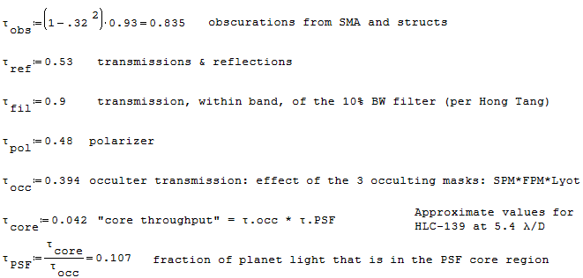



Coronagraph Throughput Contributions
Telescope
T2
T1
COR F1
M3
COL F1
COR F2
From SNR repository rev 422: 20160406 Nemati Rates for Typical Observation.sm
M4
COL F2
Collimator Bench
Pupil mask
Focal Plane mask
Lyot
mask
Field stop
mask
Filter
wheel
IFS/Img Selector
FSM
Coronagraph Bench
R1 OAP2
DM1
R2 OAP2
R1 OAP1
FocM
FPA
DM2
R2 OAP1
FM
R3 OAP1
R3 OAP2
FS OAP1
FS OAP2
Radiation Shield Mirror
to LOWFS
PBS

Slide 5
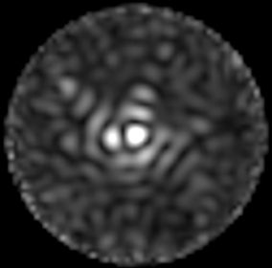
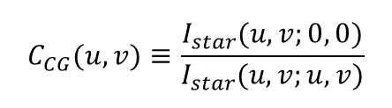

Coronagraph Contrast
The Coronagraph contrast is computed on a per pixel basis.
Steps to getting contrast at $(u,v)$
Propagate a flat wavefront (corresponding to the star being at 0,0) through the optical system, from the primary all the way to the imager
Obtain the intensity distribution $I(u,v;0,0)$ in the focal plane
Normalize the intensity distribution to the total incident power (photons/second) incident on the unobscured parts of the primary.
Repeat with a tilt applied to the incoming wavefront so that the star is effectively at $\left(u,v\right)$ → this gives $I(u,v;u,v)$
Divide the intensity distribution in step 2 by the PSF peak in step 3
OWA
evaluate
source
IWA ~ 3 λ/D
(0,0)
$$C_{CG}(u,v)≡\frac{I_{star}(u,v;0, 0)}{I_{star}(u,v;u,v)}$$
Dark Hole with Speckle
(u,v)

Slide 6
Using the Coronagraph Contrast Tables
The HLC polx and PIACMC tables include the attenuation (throughput loss)
due to the polarizer for I, core_thruput, PSF_peak, and occ_trans
so, to calculate the mean speckle level, the throughput
Below are excerpts from two contrast table files for the HLC design
---------------------------------------------------------------------------------------------------------------------------
r(lam/D) r(arcsec) I contrast core_thruput PSF_peak area(sq_arcsec) occ_trans
---------------------------------------------------------------------------------------------------------------------------
............. hlc_20140623-139_0.4mas_jitter_results.txt ................................................................
3.00000 0.143602 1.1689422e-11 3.8758899e-09 0.022367177 0.0030159324 0.0020705070 0.39442343
3.30000 0.157962 6.6227517e-12 1.5575568e-09 0.030859951 0.0042520129 0.0020109240 0.39442343
5.40000 0.258484 4.5271587e-12 7.9960251e-10 0.041660457 0.0056617615 0.0020556112 0.39442343
............. hlc_20140623-139_0.4mas_jitter_results_polx.txt ...........................................................
3.00000 0.143602 1.6973625e-12 1.1255972e-09 0.011183589 0.0015079662 0.0020705070 0.19721172
3.30000 0.157962 1.5311561e-12 7.2020295e-10 0.015429976 0.0021260064 0.0020109240 0.19721172
5.40000 0.258484 1.1051182e-12 3.9037963e-10 0.020830229 0.0028308807 0.0020556112 0.19721172
...........................................................................................................................
Reductions due to reflections, CCD QE are omitted. Coronagraph mask throughputs
are included. Polarizer reduction is included as noted below.
> I = mean speckle intensity at r, normalized to flux incident on primary
> contrast = I(r) / PSF_peak(r)
> core_thruput = fraction of light incident on primary that makes it into the FWHM region of a field PSF centered at r
> PSF_peak = fraction of light in peak pixel of field PSF centered at r normalized to flux incident on primary
> area = area of the FWHM region of the field PSF centered at r
> occ_trans = occulter * lyot stop transmission at r
> Pixel sizes (for I, PSF_peak): hlc, piaacmc = 0.3 lam/D, spc = 0.2 lam/D
> Reduction by 0.5 due to polarizer included in HLC polx and piaacmc values for: I, core_thruput, PSF_peak, and occ_trans
...........................................................................................................................
Documentation in setupAFTA.m

Slide 7
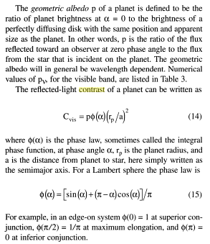


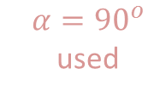


Planet Contrast
Planet contrast is independent of the instrument. It is simply the ratio of the flux arriving at the instrument aperture from the planet divided by the same from the star.
Traub & Oppenheimer
albedo
$$C_{pl}=P⋅φ\left(α\right)⋅{\left(\frac{r_{p}}{a}\right)}^{2}$$
Phase law
Exo system
LOS
$$a$$
$$r_{p}$$
$$α$$
(simple case of 90 deg inclination angle shown)
planet
$$α={90}^{o}$$ used
Observer
% Planet contrast C = albedo * phi(alpha) * (r_p / SMA)^2;
% phi(alpha) = (sin(alpha) + (pi-alpha)*cos(alpha)) / pi , where alpha = phase angle

Slide 8
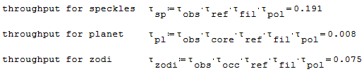
Attenuation Factors and Throughput
Because of the way the coronagraph contrast is defined, the following differences apply to the photometric attenuation factors for planet, speckle and zodi:
Core throughput
 | Obsc | Reflec | Occulter | PSF | Filter | Polariz
Planet | X | X | X | X | X | X
Speckle | X | X | 1 | 1 | X | 1
Zodi | X | X | X | 1 | X | X
X $:$ Needs to be included separately: it is not in the contrast table
HLC Pol-x Example
For example, when calculating the mean speckle level, we start with John Krist’s contrast, and apply losses from obscuration, all the reflections, and the filter. Some of the contrast tables (e.g. PIAA and HLC non-Pol-x) do not include polarizer effect so for those another factor of ~0.5 must also be applied.
So we can use this table to get the various throughputs:

Slide 9



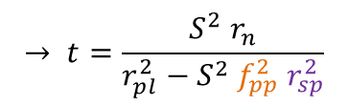
Important metric: Requisite time to reach SNR
Analytical expression for SNR:
$SNR≡S=\frac{Signal}{σ_{tot}}$ where $\left\{\begin{matrix}signal=r_{pl} t \\ σ_{tot}=\sqrt{r_{n} t+σ_{s}^{2}}\end{matrix}\right.$
planet rate:
$$r_{pl}={f_{SR} Φ}_{∗} C_{pl} A_{PM} τ_{pl} η$$
$f_{SR}≡$ fraction of core light in region of interest for SNR
Temporal noise rate
planet
speckle
zodi
dark
clk. Ind. Chg.
read
$$r_{n}={f_{SR} F}^{2}\left[{Φ_{∗} C_{pl} τ_{pl}+Φ}_{∗}C_{CG}I_{pk}m_{pix}τ_{sp}+\left(\frac{dΦ_{Z}}{dΩ} ΔΩ_{PSF}\right)τ_{Z}\right] A_{PM} η+F^{2}\left[i_{d}m_{pix}+q_{CIC}\frac{m_{pix}}{t_{fr}}\right]+\frac{m_{pix}}{t_{fr}}{\left(\frac{σ_{r}}{G_{EM}}\right)}^{2}$$
photonic (shot noise) terms
electronic terms
there is also a spatial term, the confusion noise arising from the residual speckle structure
OWA
$$σ_{s}=f_{pp}⋅f_{SR}⋅Φ_{∗}C_{CG}I_{pk}m_{pix}τ_{sp}{ A}_{PM} η t=f_{pp} r_{sp} t$$
IWA ~ 3 λ/D
mean speckle rate
$$r_{sp}$$
(0,0)
Can invert the equation to get the requisite time to get to a desired SNR:
Dark Hole with Speckle
$$→ t=\frac{S^{2} r_{n}}{r_{pl}^{2}−S^{2}{ f}_{pp}^{2} r_{sp}^{2}}$$
(u,v)

Slide 10
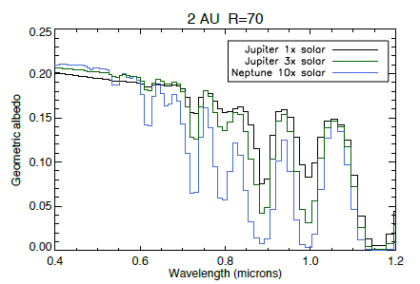
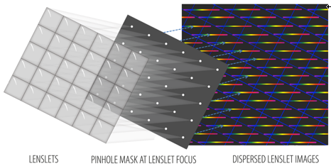
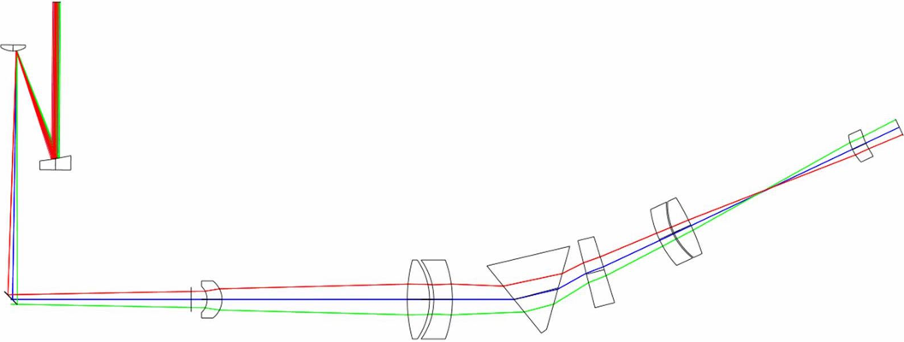
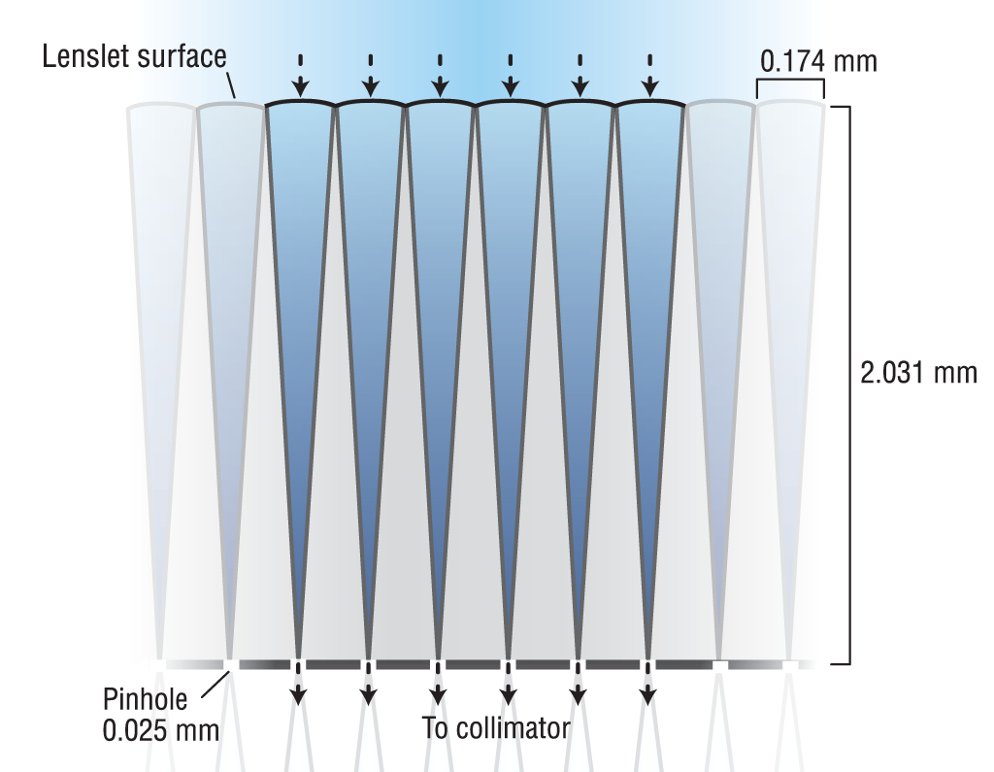
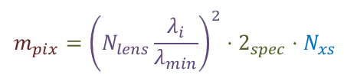
Detector Pixels in the IFS Configuration
For the IFS, the SNR region of interest (ROI) comprises the collection of pixels that altogether are involved in the photometry of a single spectral element
The system is constant-dispersion, therefore the sampling in the spectral dimension is set, and not wavelength dependent.
$$m_{pix}={\left(N_{lens}\frac{λ_{i}}{λ_{min}}\right)}^{2}⋅2_{spec}⋅N_{xs }$$
one lenslet spectrum
PSF spectrum
‘spatial’
direction
spectral direction
SNR
ROI
Imager plane
Lenslet Array
PSF
IFS Detector
Camera
WFIRST Coronagraph
IFS (PISCES)
Compound
Prism
Collimator

Slide 11








Another Correction: Differential Imaging
The factor f_{pp} assumes speckles are somehow estimated
This estimation will bring with itself some errors – both random and systematic
For the random errors, this means there will be an extra contribution to noise
The simplest way is to assume a separate reference measurement (a la RDI) gives the speckle background.
Angular differential measurement (ADI) would have a similar error.
Either way, this means doubling of the variance for all terms except the signal shot noise
The noise rate would change to:
Target
Reference
$$P$$
$$B_{tar}$$
$$B_{ref}$$
Tar – Ref
(RDI)
$$P$$
$$S=S_{tar}−S_{ref}$$
$$=\left(P+B_{tar}\right)−B_{ref}$$
$$=P+\left(B_{tar}−B_{ref}\right)$$
$$δS=δP+\sqrt{2} δB$$
for the random background
$$r_{n}=F^{2}\left[2\left(Φ_{∗}C_{CG}I_{pk}m_{pix}τ_{sp}+\frac{dΦ_{z}}{dΩ}ΔΩ_{PSF}τ_{Z}\right)\right]A_{PM} η+2 F^{2}\left(i_{d}m_{pix}+q_{CIC}\frac{m_{pix}}{t_{fr}}\right)+2\frac{m_{pix}}{t_{fr}}{\left(\frac{σ_{r}}{G_{EM}}\right)}^{2}$$
However, if there is a library of reference images, it is possible that this factor of 2 would not apply.

Slide 12








Equivalent Contrast
It might be helpful to factor the equations a little differently to see how the SNR improves with time.
Consider the noise variance, which can be broken up into temporal and spatial terms:
$$σ_{tot}^{2}=σ_{t}^{2}+σ_{s}^{2}$$
Using the earlier slide’s definitions:
$$\frac{σ_{t}^{2}}{t}=r_{n}={f_{SR} F}^{2}\left[{Φ_{∗} C_{pl} τ_{pl}+Φ}_{∗}C_{CG}I_{pk}m_{pix}τ_{sp}+\left(\frac{dΦ_{Z}}{dΩ} ΔΩ_{PSF}\right)τ_{Z}\right] A_{PM} η+F^{2}\left[i_{d}m_{pix}+q_{CIC}\frac{m_{pix}}{t_{fr}}\right]+\frac{m_{pix}}{t_{fr}}{\left(\frac{σ_{r}}{G_{EM}}\right)}^{2}$$
$$σ_{s}^{2}=f_{pp}⋅f_{SR}⋅Φ_{∗}C_{CG}I_{pk}m_{pix}τ_{sp}{ A}_{PM} η t=f_{pp} r_{sp} t$$
Equivalent Contrast Definition:
The planet that will be detected with SNR of $S$after integrating for time t is one which has a planet-contrast
equal to the S-$σ$ equivalent contrast. The signal for such a planet is given by:
$$Φ_{∗}C_{eq}τ_{pl} t=S{⋅σ}_{tot}$$
We are typically interested in the case $S=5$, so we talk about the $5σ$ equivalent contrast.
Here, absorbed A and $η$ into $τ_{pl}$
$σ_{t}$ dominated; not much benefit
from post-processing
For imaging, $f_{SR}=1$, so for simplicity we drop this factor, and we have:
$$C_{eq}$$
$$C_{eq}=\frac{S{ σ}_{tot }}{{Φ_{∗}τ}_{pl} t}=S\sqrt{\frac{r_{n}t+f_{pp}^{2}r_{sp}^{2}t^{2}}{{Φ_{∗}^{2}τ_{pl}^{2}t^{2}}_{ }}}=S\sqrt{\frac{r_{n}}{{Φ_{∗}^{2}τ}_{pl}^{2} t}+f_{pp}^{2}\frac{r_{sp}^{2}}{Φ_{∗}^{2}τ_{pl}^{2}}}$$
t
Due to the statistical nature of the data that goes into achieving $f_{pp}$, it is implicitly a function of time, so we really can write it as $f_{pp}\left(t\right).$For short integration times, we can expect $f_{pp}$ to be decreasing (random errors) while for long times drifts will cause it to flatten or even increase.
For very short times the first term dominates and there is no benefit from post-processing
At large times, the first term under the radical drops out, so that we arrive at:
$$C_{eq}\underset{→}{\text{t}→∞}S f_{pp}\left(t\right)\frac{r_{sp}}{Φ_{∗}τ_{pl}}$$

Slide 13
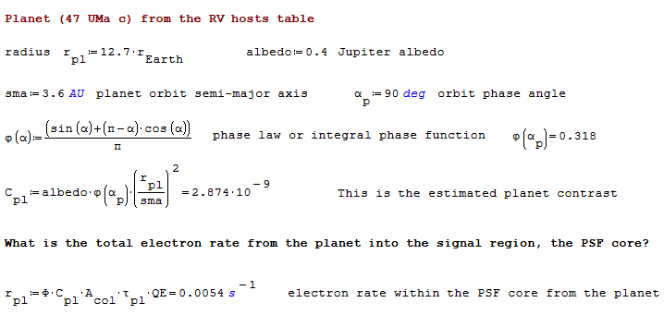
Example Calculation: Planet Signal
The planet signal is calculated by starting with the planet contrast and applying the attenuation from PSF core fraction

Slide 14
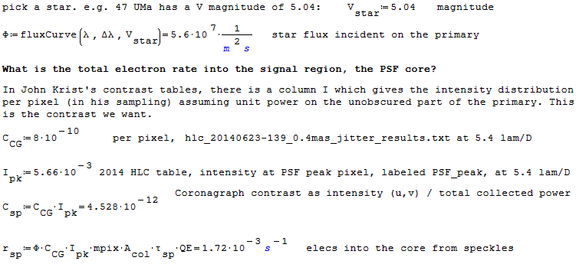
Example Calculation: Speckle Background

Slide 15
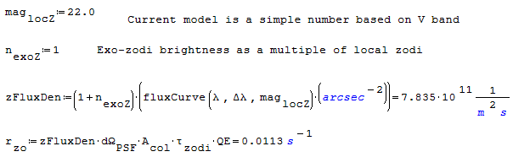

Example Calculation: Zodi Background
Zodi background is an extended source
The PSF core fraction $τ_{PSF}$ does not apply to Zodi

Slide 16
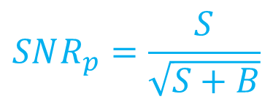
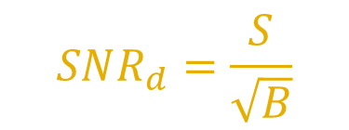
Aside: Distinguishing types of SNR
Detection and spectroscopy are different, statistical questions.
For planet detection, with the imager, we would be interested in detection SNR:
For spectrometry, with the IFS, we are interested in the photometric SNR:
$$SNR_{d}=\frac{S}{\sqrt{B}}$$
$$SNR_{p}=\frac{S}{\sqrt{S+B}}$$

